Slide 1
Data Structure Linked-List
Under the supervision of Dr. Hesham Hamed

Slide 2
TABLE OF CONTENTS
01
04
02
05
03
06
Introduction To Data Structure
Basic operations
What is a Linked list ?
Operations Code in C++
Types of Linked list
Linked list Function Code in C++

Slide 3

What’s Data Structure?
01
A data structure is a specialized format for organizing, processing, and storing data in a computer so that it can be used efficiently. Examples include arrays, linked lists, stacks, and queues

Slide 4
TYPES OF DATA STRUCTURES
1
2
Primitive
Non -Primitive
Primitive Data structures are directly supported by the language and any operation is directly performed in these data items. Ex: integer, Character, Real numbers, etc.
Non-primitive(user-defined) data types are not defined by the programming language but are instead created by the programmer.

Slide 5
Difference between Linear and Non- Linear Data Structure
Linear Data Structure | Non-Linear Data Structure
Every item is related to its previous and next time. | Every item is attached with many other items.
Data is arranged in linear sequence | Data is not arranged in sequence.
Data items can be traversed in a single run | Data cannot be traversed in a single run.
Eg. Array, Stacks, linked list, queue | Eg. tree, graph
Implementation is easy | Implementation is difficult

Slide 6

What is a linked list?
02
A LinkedList is a linear data structure where elements, called nodes, are linked together using pointers. Each node contains two parts: the data and a reference (or pointer) to the next node in the sequence. Unlike arrays, LinkedLists do not store elements in contiguous memory locations, making them efficient for insertions and deletions. There are different types of LinkedLists, including singly, doubly, and circular linked lists, each offering different functionalities based on how the nodes are connected.

Slide 7
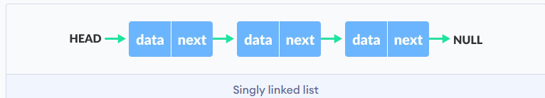
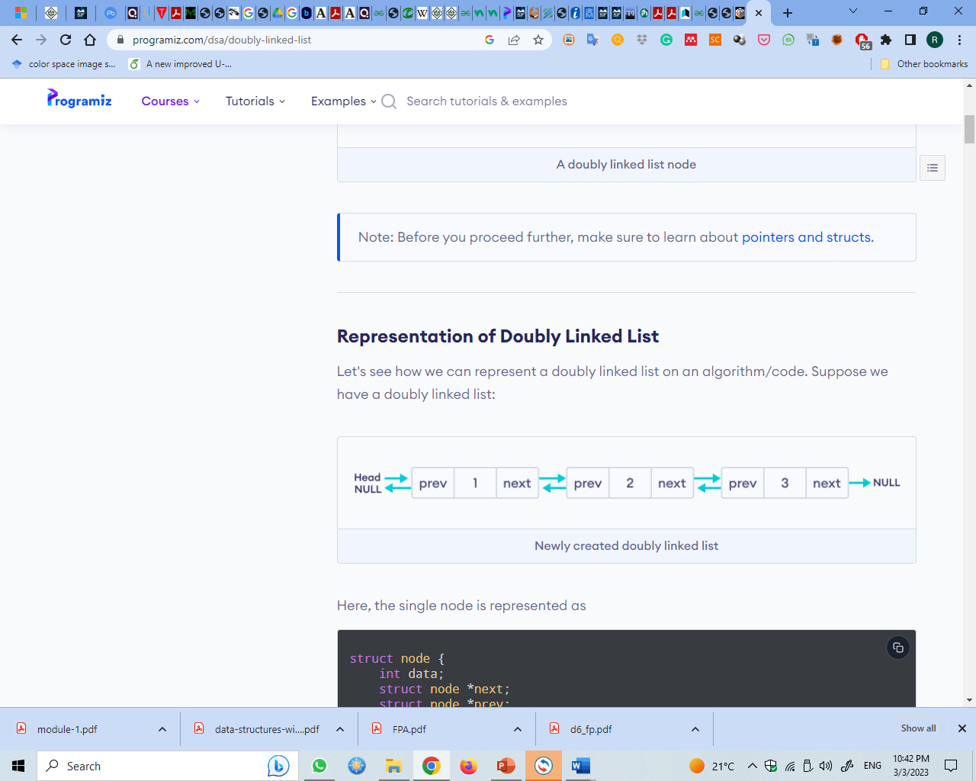
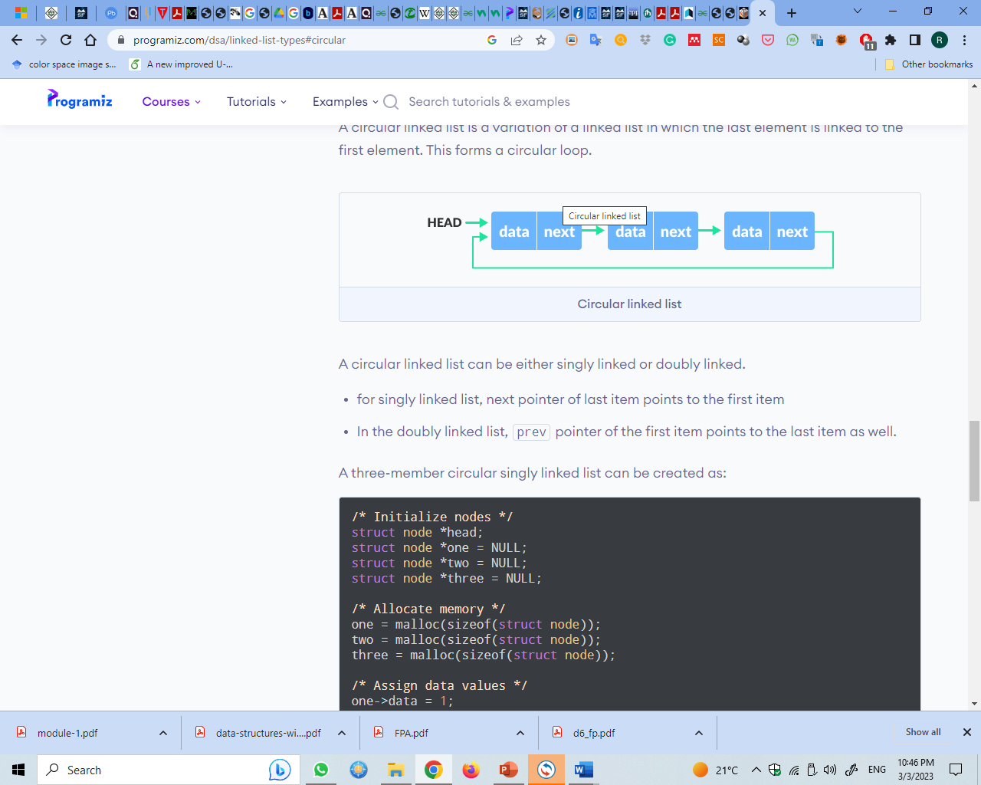
Types of linked list?
Simple Linked List − Item navigation is forward only.
Doubly Linked List − Items can be navigated forward and backward.
Circular Linked List − Last item contains link of the first element as next and the first element has a link to the last element as previous.

Slide 8
The basic operations supported by a list.
04
Insertion
Deletion
Traverse
Search
Delete
Replace

Slide 9
Basic Operations
Insertion − Adds an element at the beginning of the list.
Deletion − Deletes an element at the beginning of the list.
Traverse − Displays the complete list.
Search − Searches an element using the given key.
Delete − Deletes an element using the given key.

Slide 10
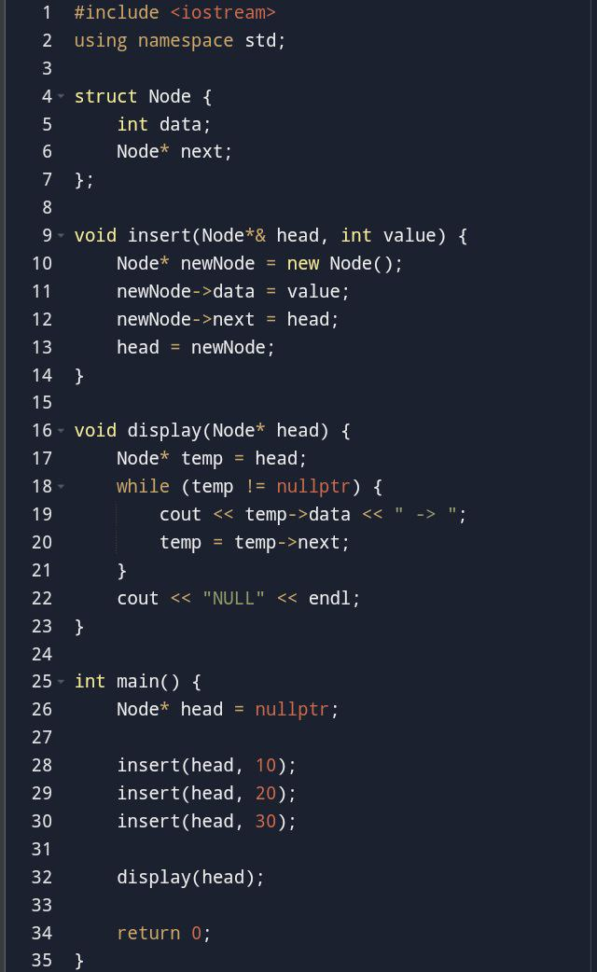
linkedlist nsert with display code in c++ :

Slide 11
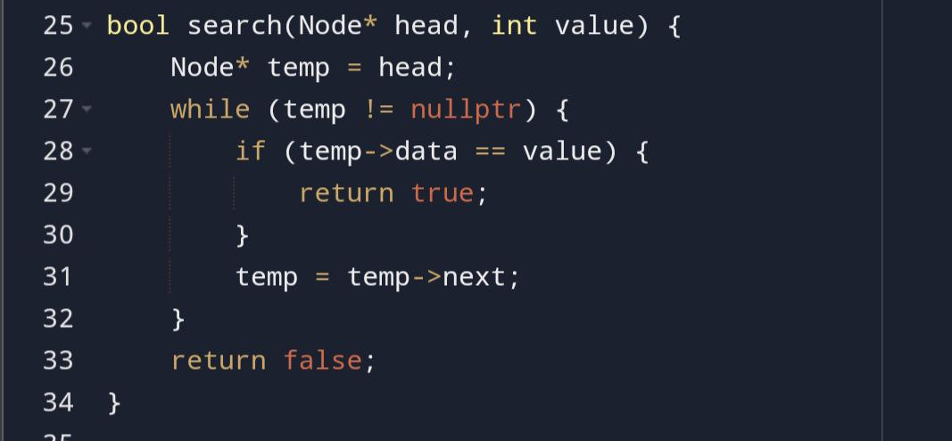
linkedlist search in code c++

Slide 12
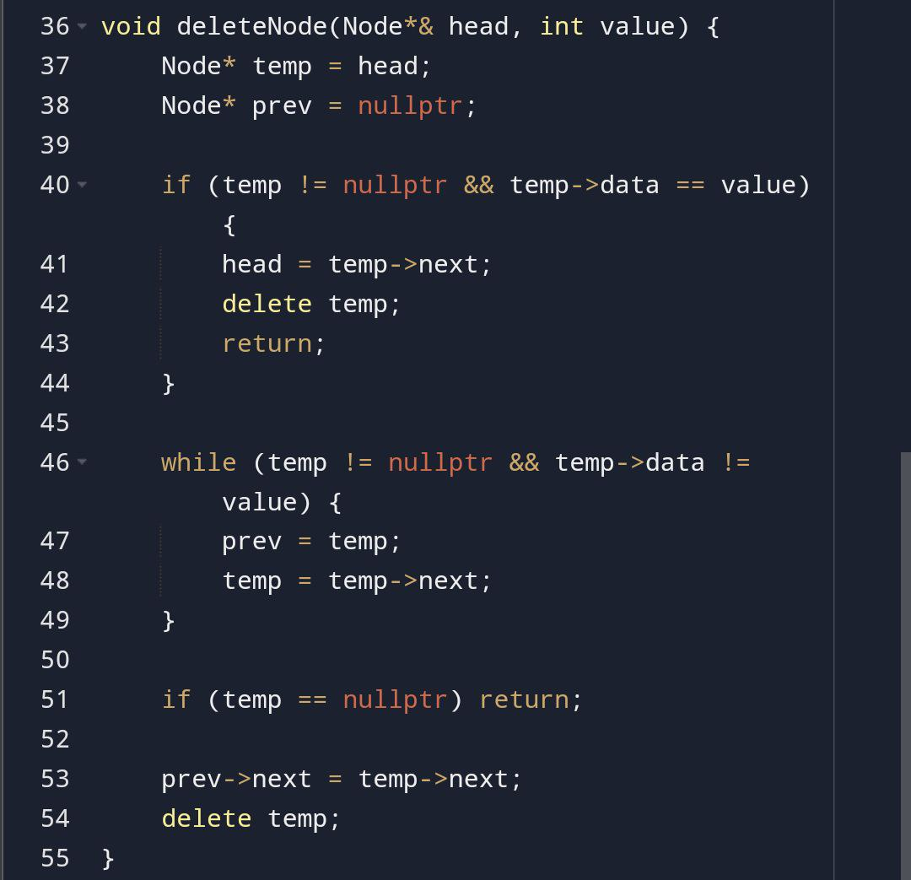
linkedlist delete in code c++

Slide 13
Linked-list code in c++👉🏻

Slide 14
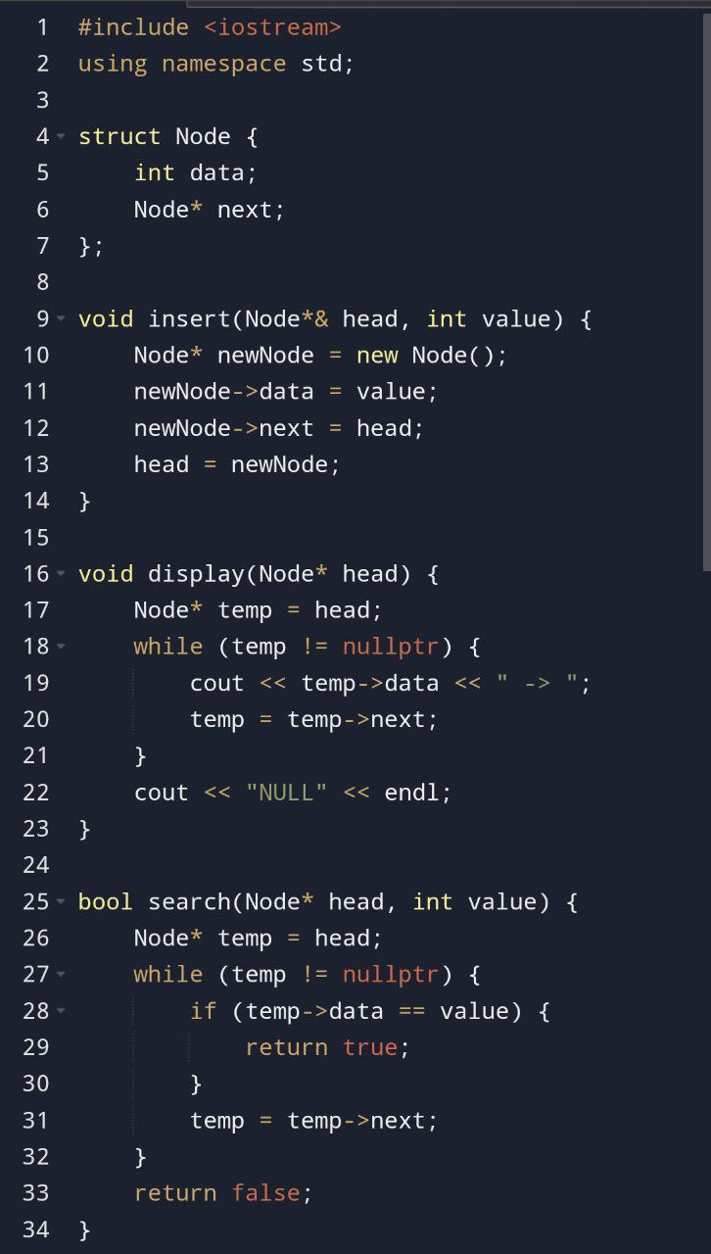
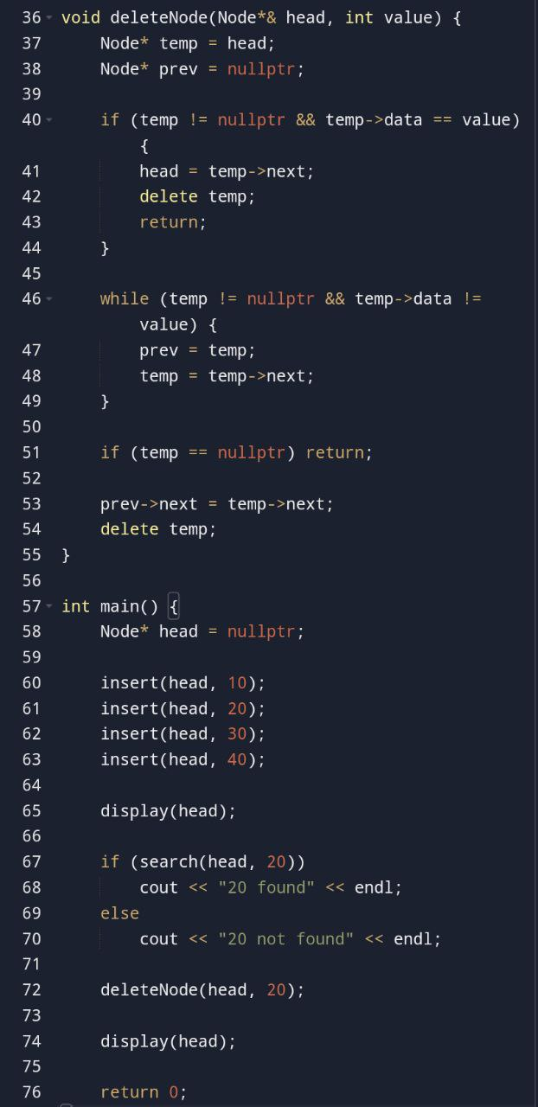

Slide 15
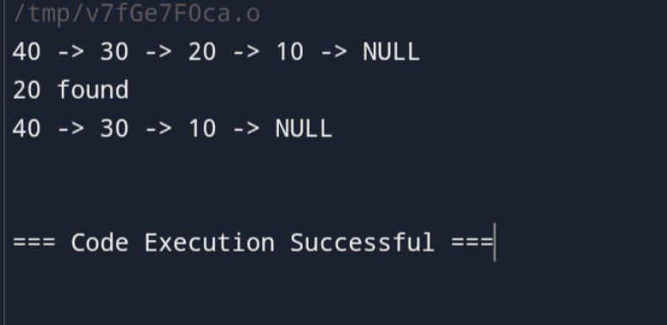
Output of code

Slide 16
upervised by: Dr. Hesham Hamed
THANKS
Do you have any questions?
Prepared by:
Mahmoud naser taher
Mostafa Abd-elbaset mohammed

